Slide 1

BANK LOAN ANALYSIS
BY SARFARAZ AHMED MULLA

Slide 2
PROJECT DESCRIPTION
Being a data analyst perform exploratory data analysis to analyze patterns in the data to ensure that capable applicants are not rejected . Analyzing whether the applicant can repay the loan or not or applicant cannot repay the loan and is approved . checking for payment difficulties and make decisions such as denying the loan, reducing the amount of loan, or lending at a higher interest rate to risky applicants. The company wants to understand the key factors behind loan default so it can make better decisions about loan approval.
dataset used for analysis is : 1. application_data
2. perviousapplicaion_data.

Slide 3
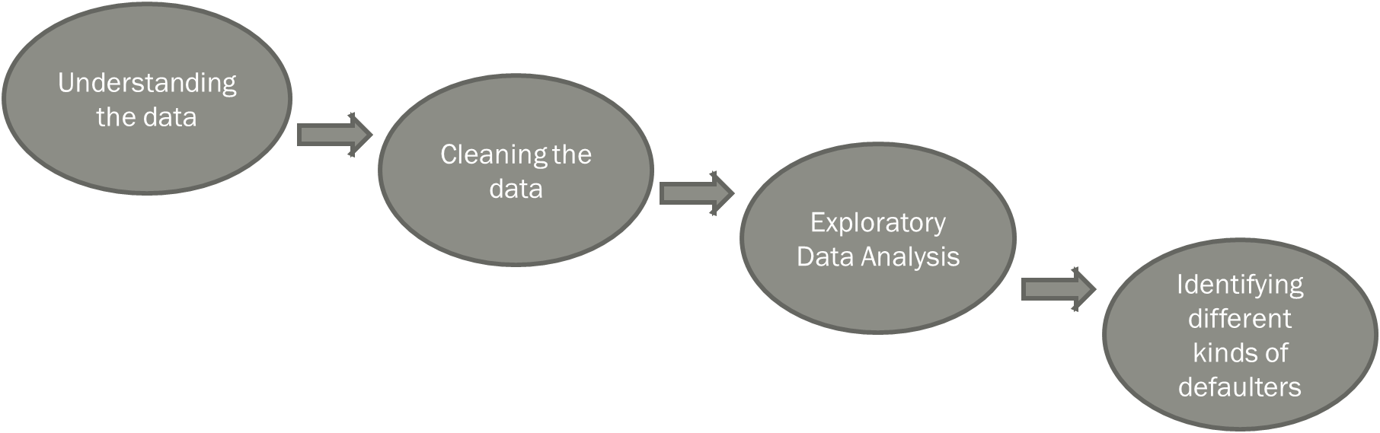
APPROACH

Slide 4
Tech – Stack Used
MICROSOFT EXCEL 2016
Used for data cleaning and insight analysis using pivot tables and other excel features.

Slide 5
INSIGHTS
A. Data Cleaning
B. Identify Outliers in the Dataset:
Application Data and previous application data
Checked columns for null values and removed columns having null values greater than 40% for application data and removed columns having null values greater than 30% for previous application data and the columns which are not necessary for analysis from both the datasets.
Imputing null values with suitable values (mean or median)
Binning certain columns into categorical columns which will be used for analysis.
Checked the datatype of variables and converted them into suitable data types.
Checked the dataset for duplicates and found that there are no duplicate values.
total rows 307512 after data cleaning 49834
AMT_INCOME_TOTAL has huge number of outliers which indicate that few of the loan applicants have high income when compared to the others using the QUARTILE, IQR.
YEARS_EMPLOYED has 8893 outliers when calculated the calculation were about -1001 years which is impossible.
AMT_GOODS_PRICE the price of an average goods is around 2000000 there are few outliers in that particular where product cost over 2000000.
AMT_ANNUITY 70000 is the average amount there are few outliers in that particular dataset.

Slide 6
D. Univariate Analysis , segmented Univariate Analysis , Bivariate Analysis
AMT_INCOME_TOTAL , AMT_GOODS_PRICE, AMT_ANNUITY , AMT_CREDIT have been used to scatter plot the data to analysis
Data is segmented in data set so that it was all the data points
In Bivariate analysis I have compared 2 data variables such as NAME_TYPE_SUITE, NAME_INCOME_TYPE, NAME_EDUCATION_TYPE, NAME_HOUSING_TYPE
Different types of defaulters and non defaulters o have a better perspective about defaulters
maximum defaulters are from following categories
unaccompanied , family - NAME_TYPE_SUITE
working - NAME_INCOME_TYPE
secondary/secondary special - NAME_EDUCATION_TYPE
house /apartment - NAME_HOUSING_TYPE
C. Analyze data Imbalance
Repayers percentage is 92%
Defaulter percentage is 8%.
E. CORRELATION
TOP CORRELATION ARE BETWEEN
AMT_GOODS_PRICE AND AMT_CREDIT
AMT_GOODS_PRICE AND AMT_ANNUITY
AMT_ANNUITY AND AMT_CREDIT
LEAST CORRELATION IS BETWEEN
REGION_POPULATION_RELATIVE AND REGION_RATING_CLIENT
INCOME TYPE AND ORGANISATION TYPE
REGION_RATING_CLIENT AND AMT_ANNUITY

Slide 7
RESULTS

Slide 8
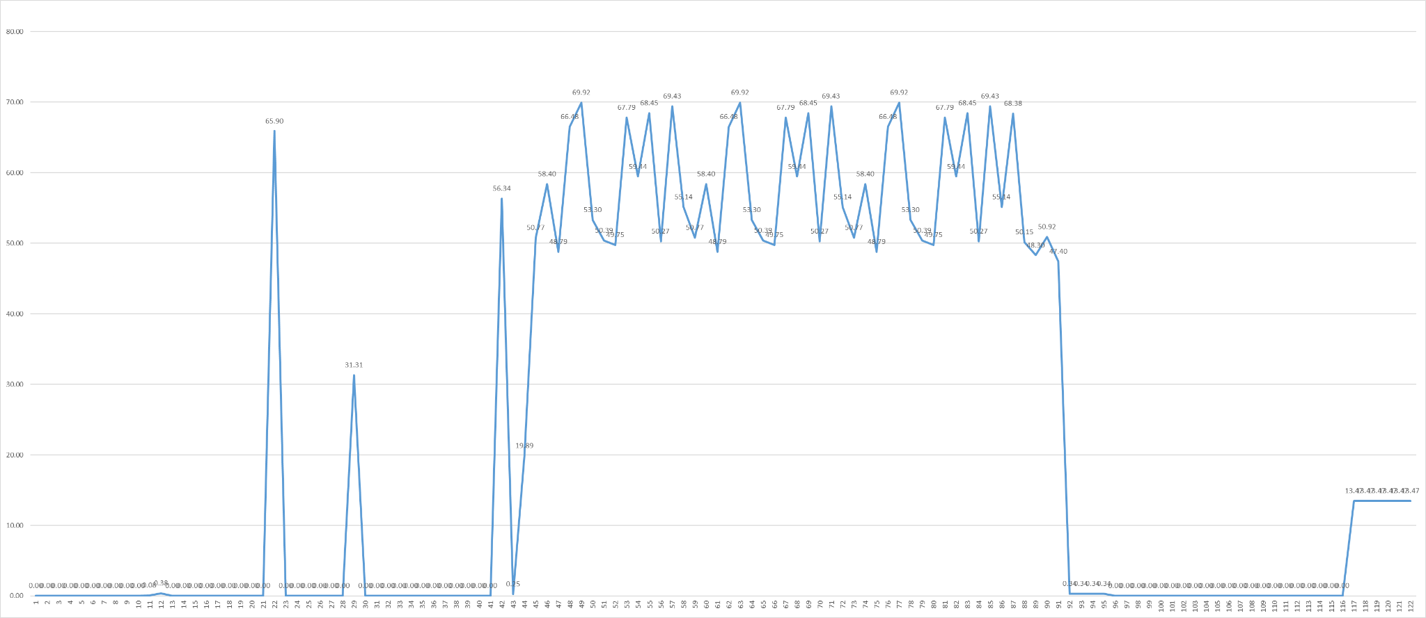
INSIGHT 1 : DATA CLEANING
X AXIS : EACH COLUMN IS REPRESENTED WITH NUMBER IN SEQUENTIAL ORDER
Y AXIS : PERCENTAGE OF EMPTY COLUMNS

Slide 9
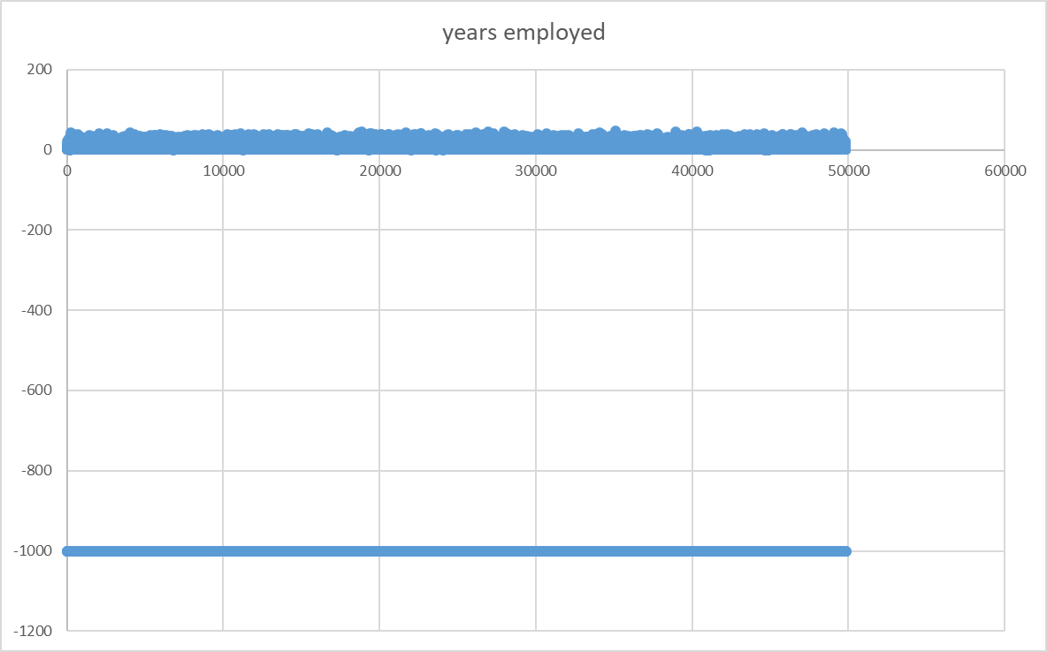

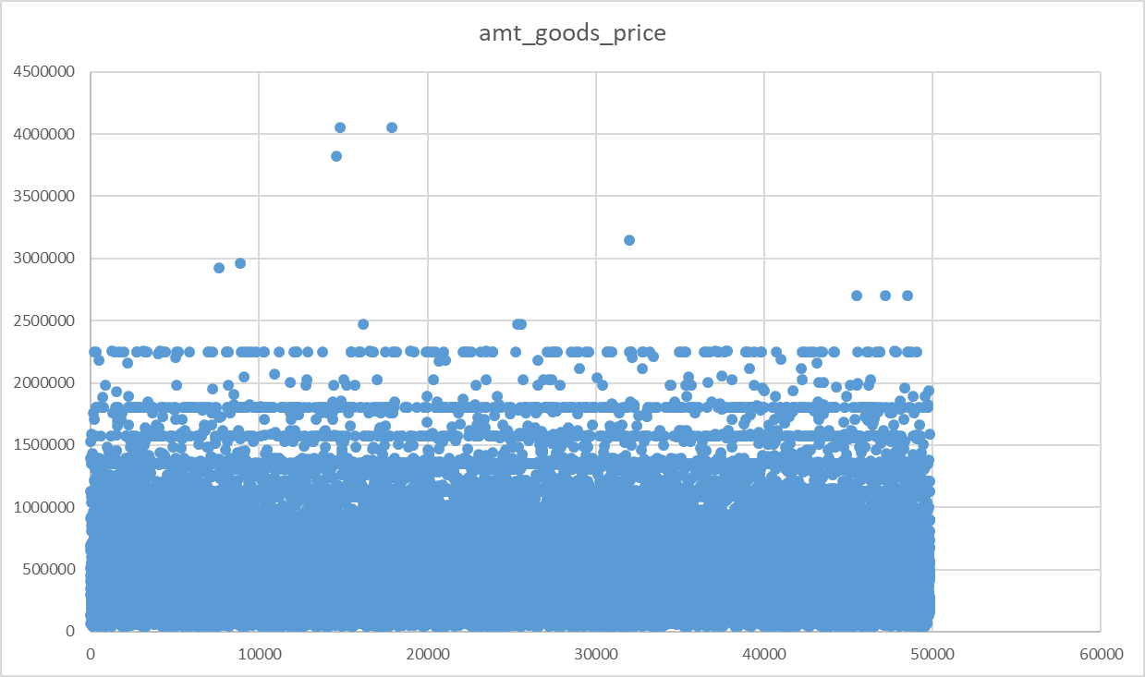
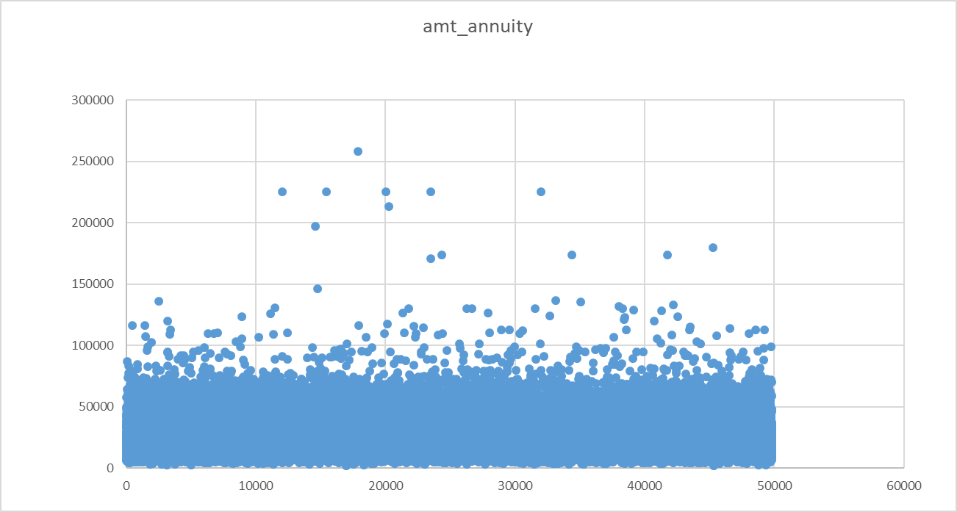
INSIGHT 2 OUTLIERS

Slide 10
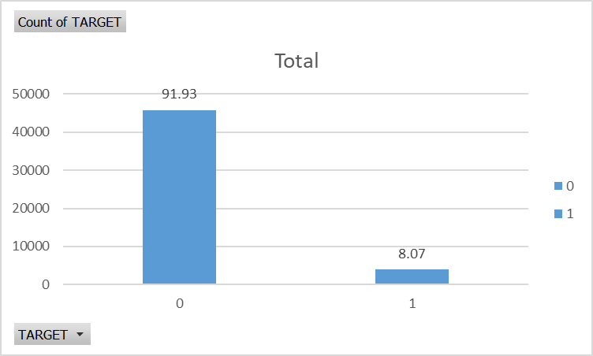
INSIGHT 3 DATA IMBALANCE

Slide 11
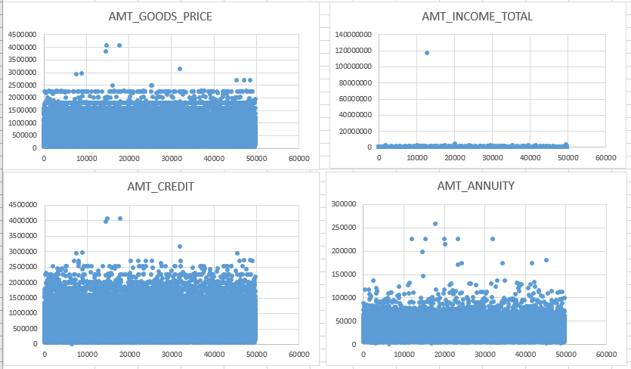
INSIGHT 4
UNIVARIATE ANALYSIS

Slide 12
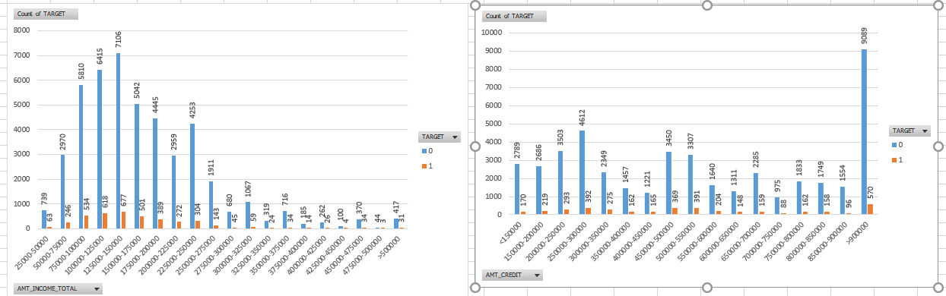
SEGMENTED UNIVARIATE ANALYSIS

Slide 13
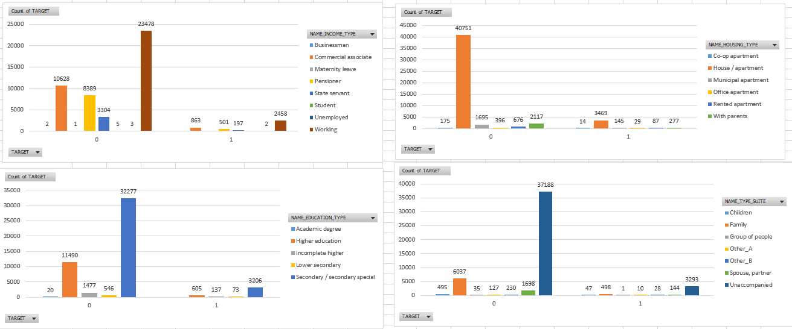
BIVARIATE ANALYSIS

Slide 14
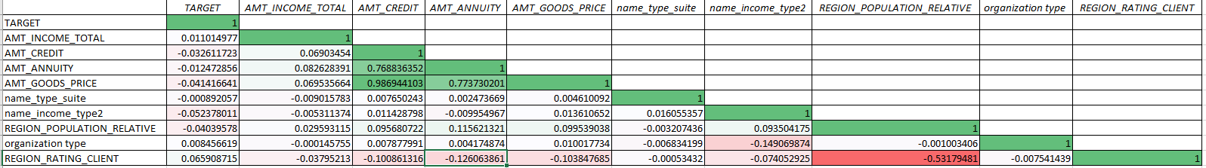
INSIGHT 5 CORRELATION

Slide 15
DEFAULTERS
Maximum defaulters are from the the following category
NAME_INCOME_TYPE WORKING CATEGORY (15224)
NAME_EDUCATION_TYPE SECONDARY/SECONDARY SPL(19524)
NAME_HOUSING_TYPE HOUSE / APARTMENT (21272)
NAME_FAMILY_STATUS MARRIED (14850)
In these following categories have the highest number of defaulters bank should review applications from these categories before passing loan and charge premium if they fall under all the following categories as high chance of defaulting the payments .
From previous application data compare if the client has repaid all his loans or not and check for application rejected but has cleared all the loans so that bank does not loose any potential customers

Slide 16
Final dataset link
https://docs.google.com/spreadsheets/d/1QfDRT-GVZk0D7HTAnl_NZRTDmDM9XLK3/edit?usp=drive_link&ouid=112349825885166255529&rtpof=true&sd=true

Slide 17
Video link
https://loom.com/share/folder/c177fb7f0c4b4bc39cdfc07effa1cfc4
NOTE :The video was shot in 3 parts as there was a time limit in loop

